Slide 1

Round-Trip Time Measurement in FABRIC
Vaibhav Sharan
Notes:
This paper presents a comprehensive study of Round-Trip Time within the FABRIC testbed network. RTT, a fundamental metric of network performance, serves as a crucial determinant of user experience and the overall quality of a network. This study explores RTT, delving into its impact on user satisfaction and network efficiency. To achieve these objectives, various RTT measurement methods are compared. These methods include One-way Latency utilizing Precision Time Protocol , an algorithm implemented in the data-plane using P4 programmable BMv2 switches, continuous TCP traffic analysis in the application layer, and the traditional UNIX ping command. By using these techniques, this study provides an understanding of RTT measurement behaviors.

Slide 2
Why study Round-trip times?
High RTT values directly translate to delays in data transmission, leading to diminished user experience.
Round-Trip Time is one of the basic metrics indicating the quality of the network.
Detecting IP Spoofing
BGP Routing Security
Notes:
The motivation behind this study stems from the crucial role RTT plays in shaping the digital experience of millions of users worldwide. In an era where real-time applications and services are ubiquitous, users expect instant responses. High RTT values directly translate to delays in data transmission, leading to frustrated users and diminished user experience.
A spoofed IP address shows inconsistent RTT values than the legitimate traffic from the same address, therefore RTT can be used to improve the accuracy for IP spoofing detection.
When an attacker uses BGP routing attacks to detour and intercept traffic, that traffic would likely experience higher-than-normal RTT. Thus, unexpected changes in the RTT to a remote host may signal a reroute, either due to equipment failure, or a routing attack.

Slide 3
Objective of the study
Perform a comprehensive analysis of Round-Trip Time within the FABRIC testbed network.
To gain insights on the difference between various RTT measuring methods.
Find the reasons behind their behavior.
To determine the accuracy of various methods.
Notes:
this study is to help researchers who are performing experiments on FABRIC to be more efficient and successful in creating experiments for harmonious integration of technology into our daily lives.
I am hoping to gain insights on the difference between different RTT measuring methods and the reasons behind their behavior and the accuracy of various methods.

Slide 4
Related work
“Variability in TCP round-trip times”. Jay Aikat, Jasleen Kaur, F. Donelson Smith, Kevin Jeffay. IMC '03: Proceedings of the 3rd ACM SIGCOMM conference on Internet measurement. October 2003, 279–284, doi: 10.1145/948205.948241
“Measuring TCP Round-Trip Time in the Data Plane”. Xiaoqi Chen, Hyojoon Kim, Javed M. Aman, Willie Chang, Mack Lee, and Jennifer Rexford. Proceedings of the Workshop on Secure Programmable Network Infrastructure (SPIN '20). Association for Computing Machinery, New York, NY, USA, 35–41, 2020, doi: 10.1145/3405669.3405823.
Notes:
The first paper presents a data-plane algorithm that passively and continuously monitors the Round-Trip Time of TCP traffic, by matching data packets with their associated acknowledgments and calculating a time difference. I use their algorithm on P4 programmable switches in one of my methods.
The second paper measured and analysed the variability in round trip times within TCP connections using passive measurement techniques. This paper provided with a lot of insights for my experiments.

Slide 5
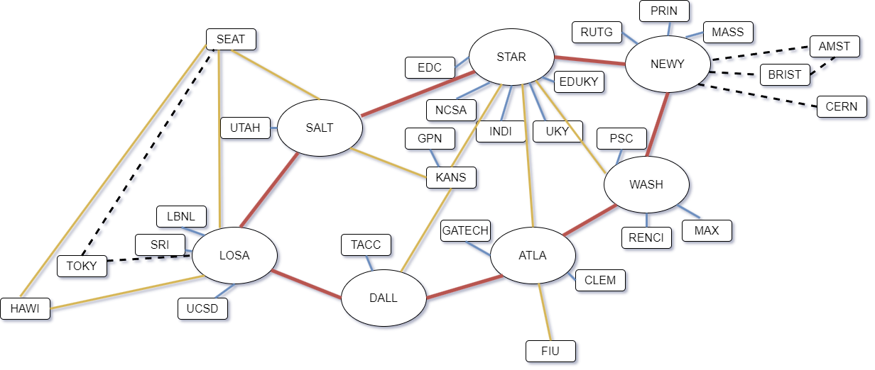

FABRIC Network
Notes:
This is the current FABRIC network. There are 7 main nodes connected through a terabit core, and to them there are 26 other nodes across the US and some of them in other countries.

Slide 6
RTT Measurement methods
One-way Latency (OWL) from MFLib
P4 Programmable Data Plane Switch
Packet capture of a continuous TCP connection in the application layer
UNIX “ping” command
Notes:
This paper studies and makes comparison between different methods of measuring RTT.
The FABRIC testbed provides a Measurement Framework library that enables the experiments to go deeper in the network slices by adding monitoring and measurement services of network nodes and traffic. I will be using one of these services is called One-way Latency. It is a network latency measurement tool which leverages Precision Time Protocol. It is different from traditional method for calculating RTT because it timestamps a UDP packet when it leaves the source and again when it is received at the destination.
An algorithm has been developed by researchers in Princeton which passively and continuously monitors the RTT of TCP traffic by calculating the time difference between packets and their acknowledgements. This algorithm is implemented in the data-plane with the help of P4 programmable high-performance BMv2 switch.
A stream of continuous TCP traffic will be sent between two nodes of the FABRIC network and the packets will be captured. This allows for measurement and analysis of the RTT behavior of the complete duration of traffic by matching the TCP packets and their corresponding acknowledgements. This is different from the previous method since this will measure the RTT on the application layer. The importance of this method lies in the fact that quite a few applications like online video games and interactive media players utilize similar method to measure RTTs for their purposes.
Finally, as a benchmark, the traditional UNIX "ping" command. This method provides a standard for comparison.

Slide 7
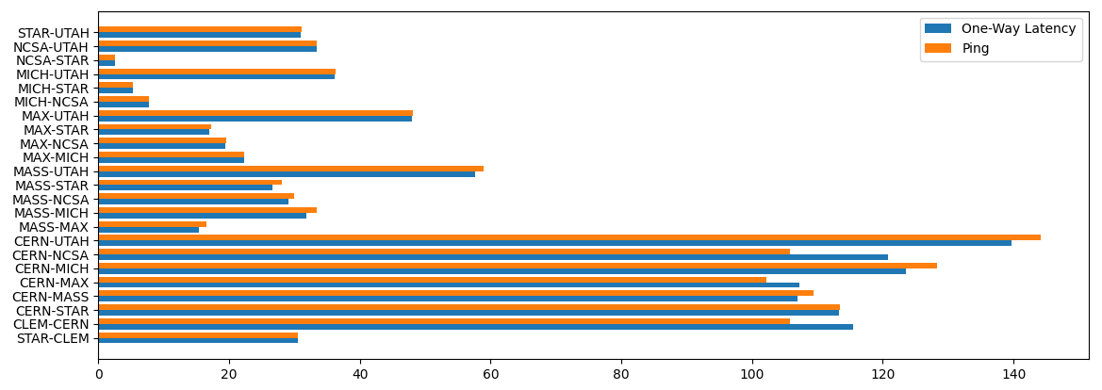
Findings till now
Notes:
This graph depicts a comparison between the observations taken till now. Initial observations point towards the fact that the RTT values from OWL method are slightly greater than that of ping. Although there are a few cases where the opposite is true. This finding might indicate OWL being a more accurate method for measuring RTTs.

Slide 8
an anomaly with the cern site
Source | Destination | One-way Latency (ms) | Standard Deviation (ms)
STAR | CLEM | 15.25 | 0.033
CLEM | STAR | 15.26 | 0.028
STAR | CERN | 51.79 | 4.237
CERN | STAR | 61.54 | 0.029
CLEM | CERN | 62.67 | 0.021
CERN | CLEM | 52.85 | 4.632
CERN | MASS | 50.88 | 4.510
MASS | CERN | 56.00 | 4.842
MASS | MAX | 7.70 | 0.074
MAX | MASS | 7.69 | 0.080
MASS | STAR | 13.31 | 0.018
STAR | MASS | 13.33 | 0.020
MICH | NCSA | 3.85 | 0.016
NCSA | MICH | 3.82 | 0.018
CERN | UTAH | 67.39 | 0.075
UTAH | CERN | 72.29 | 4.843
Notes:
CERN behaves unusually in terms of significant variations in one-way latencies compared to other sites. The underlying cause for this behavior remains unclear. One speculation I have is that this anomaly could be attributed to CERN being an international site with distinct routing paths configured for inbound and outbound traffic.

Slide 9
What’s next?
Using P4 Programmable Data Plane Switch
Packet capture of a continuous TCP connection
Notes:
The BMv2 switches along with their respective nodes have been created as of now and work towards implementation of the algorithm developed by people at Princeton is still in progress.
This method will utilize the application layer to measure RTTs from a continuous stream of TCP traffic. The observations from this method are expected to be higher than the other methods since it goes through more layers of the network stack than the other methods. More work needs to be done on method before I can use it to collect data.

Slide 10
Thanks for listening. Any questions?

